Slide 1

DEPARTMENT OF COMPUTER SCIENCE & ENGINEERING
SDM INSTITUTE OF TECHNOLOGY
“Dual sense ai for mental disorder detection”
Under the guidance of
Dr. Suchetha N V
Department of CSE
SDMIT, Ujire
Presented By
Bhavana G
Chaitanya
Chaitra
Manasa Gond
TEAM ID: 2024CSEPT5

Slide 2
INTRODUCTION
Mental health disorders affect millions of people globally, leading to decreased quality of life, and challenges in diagnosis and treatment.
With the rise of artificial intelligence (AI), advanced tools can analyze vast datasets more effectively, identifying subtle patterns that could indicate mental health disorders.
This project proposes the use of Dual Sense AI, leveraging deep learning to detect mental disorders by analyzing multi-modal data sources like voice, text, and facial expressions.

Slide 3
LITERATURE SURVEY
The research paper titled "An Automated System for Depression Detection Based on Facial and Vocal Features" has the dataset named “FER(2013)”, “Positive and Negative WordPress” and the models used are CNN(Facial Expression Detection) and Naïve Bayes Classifier(vocal detection).
The research paper titled “An AI-based Decision Support System for Predicting Mental Health Disorders” has the dataset named “SCL-90-R” and the models used are Logistic Regression(Ridge and Lasso),Random Forest(RF),Support Vector Machines(NEPAR)

Slide 4
The research paper titled “A deep Learning Approach Towards Multimodal Stress Detection" has the dataset named “MuSE” and the models used are Convolutional-Autoencoders and Recurrent Neural Networks.
The research paper titled “A Multimodal Deep Learning Framework for Mental Disorder Analysis" has the dataset named “Bipolar Disorder Corpus(BDC)”, “Extended Distress Analysis Interview Corpus(E-DAIC)”, “AVEC2019” and the models used are multi-DDAE, Fisher Vector(FV),Paragraph Vector (PV) and Deep Neural Network(DNN).

Slide 5
The research paper titled “Depression Detection Over Fusion of Visual and Vocal Expression Using Artificial Intelligence " has the dataset named “DAIC-WOZ”, “AVEC 2013”, “AVEC 2014” , “SEMAINE”, “D-Vlog” and the models used are CNN and LSTM.

Slide 6
PROBLEM STATEMENT
Detecting mental health disorders early and accurately is a major challenge due to the complex nature of these conditions and the reliance on subjective methods for diagnosis. This project aims to develop an AI-based system that uses deep learning to analyze multiple types of data, thus providing an objective, scalable, and efficient solution for early detection of mental health disorders.

Slide 7
OBJECTIVES
To develop a dual-sense AI model that can process both verbal and non-verbal data to detect early signs of mental health disorders.
To utilize deep learning algorithms to analyze multiple data sources such as facial expressions and speech to text for detecting mental health conditions.
To develop an accurate, reliable, and scalable AI system that can be used by mental health professionals to assist in early diagnosis.

Slide 8
Input Data
Facial expression dataset
Speech to text dataset
Image preprocessing
text reading
Feature extraction
Speech recognition
Model training
Display output
Model output
Combined result
Flowchart

Slide 9
METHODOLOGY
Input Data: Collect multi-modal data which includes speech to text input and facial expressions.
Image Preprocessing: Preprocess the collected data, converting it into formats suitable for deep learning models (e.g., facial data and speech to text data).
Feature selection and extraction: This is the process of locating and selecting the face in an image using Haarcascades, focus on extracting text from voice. Use NLP for final processing.

Slide 10
Model Training: Train the model using labeled data, where mental health conditions are annotated, ensuring a balanced and diverse dataset.
Example : stress, nostress,depressed,notdepressed and anxiety)
Text Reading :Reads the text from the CSV file
Speech recognition: recognizes the speech from the user
Combined Result: Combines the facial expression and speech of user and detects the disorder

Slide 11
APPLICATIONS
Clinical Diagnosis Support:The system can assist psychologists, psychiatrists, and general practitioners by providing an additional layer of analysis, especially in complex cases.
Telemedicine:The AI model can be integrated into telemedicine platforms, allowing remote diagnosis and monitoring of patients’ mental health, especially in underserved areas.
Mental Health Apps:The AI can be used in mobile applications for self-monitoring, where individuals can input speech or text data and receive feedback on their mental health status, prompting them to seek professional help if needed.

Slide 12
Workplace Mental Health Monitoring:Employers can use this technology to monitor employees' mental health in a non-intrusive manner, providing resources or interventions where signs of stress or burnout are detected.
Educational Institutions:Schools and universities can use this system to detect mental health issues among students, providing early intervention to reduce dropout rates or academic decline due to mental health challenges.

Slide 13
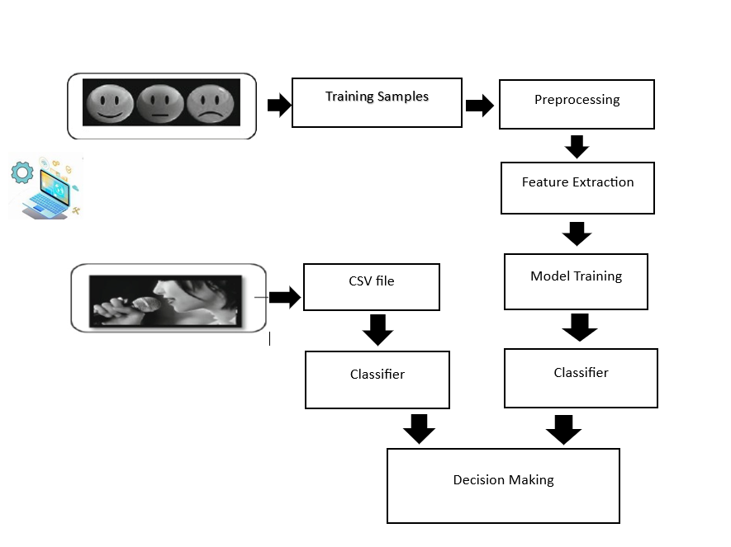
SYSTEM DESIGN

Slide 14
ALGORITHMS
CNN(convolutional neural network):
Four convolutional blocks with filters increasing from 32 to 256, each with ReLU activation.
MaxPooling: Reduces spatial dimensions after each convolutional block.
Dropout: Applied after pooling layers to prevent overfitting (drop rates between 0.1 and 0.2).
Fully Connected Layers: A dense layer with 512 units and ReLU activation.
Output layer with 5 units (one per class) and a softmax activation for multi-class classification.

Slide 15
Speech Recognition and Natural Language Processing
The code leverages the Web Speech API for speech recognition, allowing it to convert spoken input into text. This recognized text is then analyzed to determine if it matches any keywords associated with specific mental disorders.
This code primarily combines keyword-based NLP, speech recognition, and text-to-speech synthesis to analyze speech input for indicators of specific mental disorders based on keywords, as defined in an uploaded CSV file

Slide 16
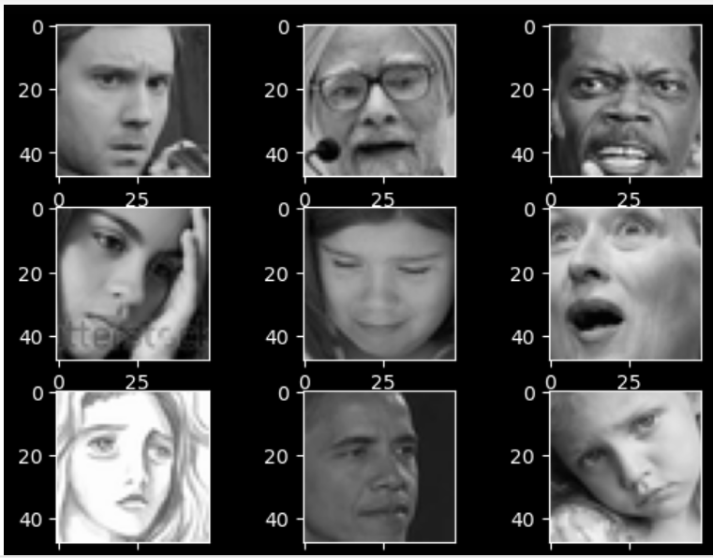
DATASETS
The dataset consist of five classes that is stress, depressed, notdepressed, anxiety and no stress

Slide 17
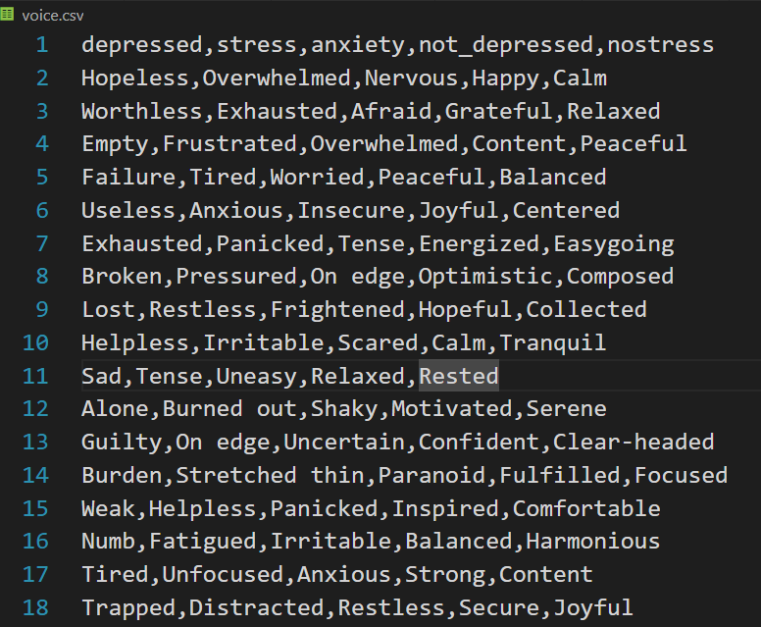
Csv dataset of speech to text stress, nostress,depressed,
notdepressed and anxiety

Slide 18
HARDWARE AND SOFTWARE REQUIREMENTS
Hardware requirements:
RAM(8.00 GB)
Processor(Intel CORE i5 processor with 2.9GHz)
Software requirement:
VS code
Jupyter Notebook

Slide 19
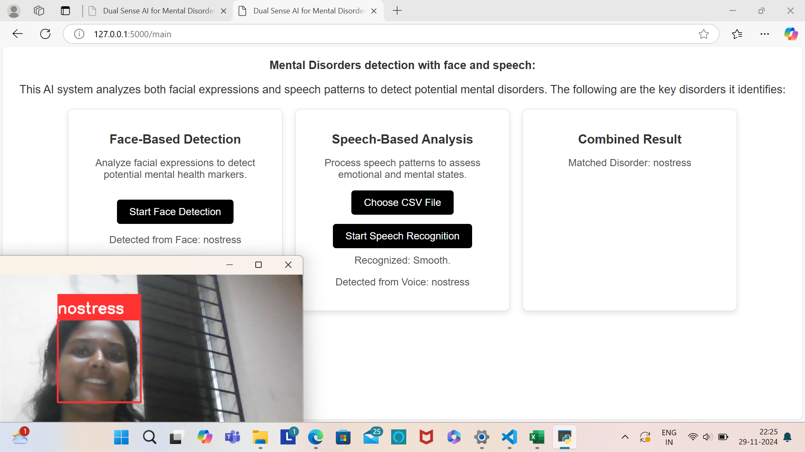
IMPLEMENTATION

Slide 20
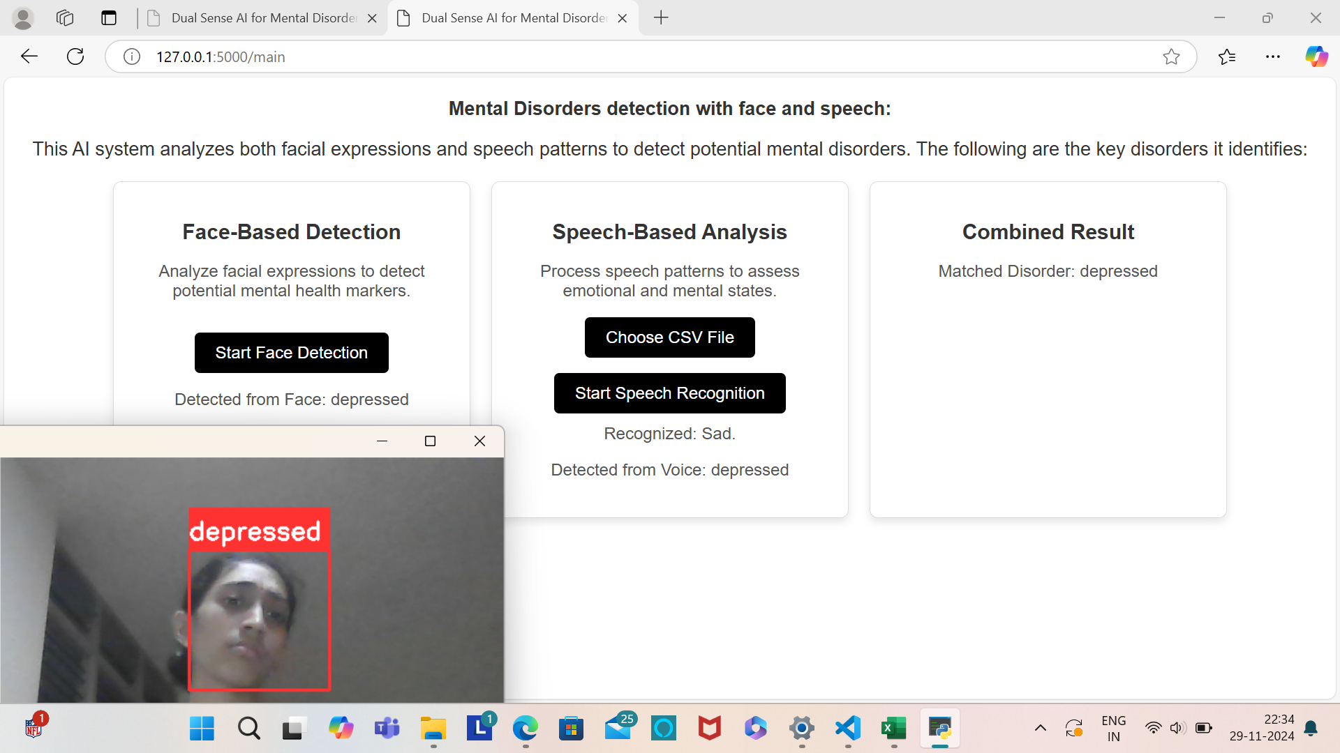

Slide 21
SYSTEM TESTING
  Test the face detection (e.g., using Haar Cascade) for proper extraction of features..
  Test the natural language processing (NLP) model for identifying keywords or emotions.
  Test the logic that combines outputs from face and text analysis to give the final result.
  Validate the model's performance and integration.

Slide 22
RESULT ANALYSIS
Analyze the results obtained using tables and graphs
Training Size | Testing Size | Accuracy (%)
 |  | CNN | NLP
 |  | 70% | 95%
80% | 20%
70% | 30% | 89% | 95%

Slide 23
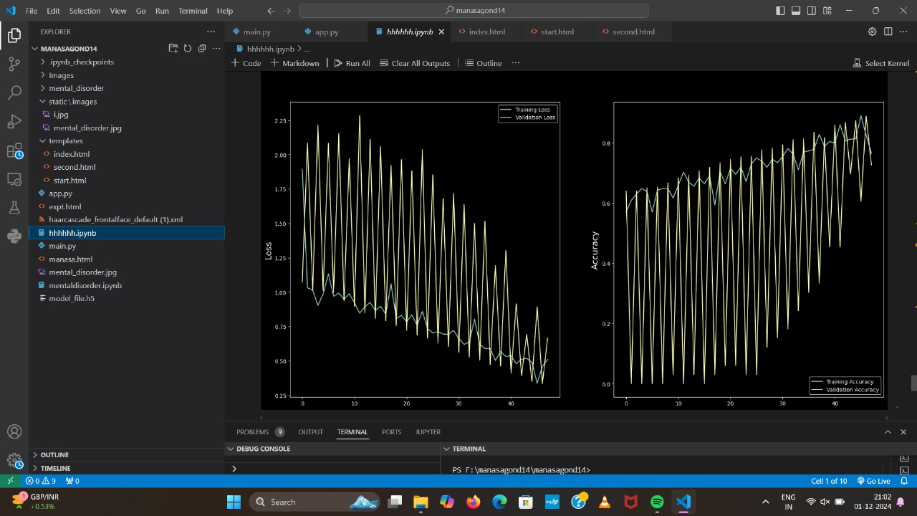
Figure : Graph analysis

Slide 24
CONCLUSION & SCOPE FOR FUTURE WORK
Application in healthcare for early diagnosis and monitoring
Real-World Deployments like Integration into smartphone apps for widespread accessibility.
Addressing ethical, privacy, and generalization challenges will be critical for real-world implementation.
Multimodal Data Integration of face and text to speech analysis.

Slide 25
REFERENCES
[1] Anastasia and P. Simos, "Automatic Assessment of Depression
Based on Visual Cues: A Systematic Review," IEEE Transactions on Affective Computing, vol. 10, no. 4, pp. 445-470, 2019.
[2] A. Castiglione and S. Hossain, "Impact of Deep Learning
Approaches on Facial Expression Recognition in Healthcare
Industries," EEE Transactions on Industrial Informatics, vol.
18, no. 8, pp. 5619-5627, 2022.

Slide 26
[3]The research paper titled “A deep Learning Approach Towards Multimodal Stress Detection" has the dataset named “MuSE” and the models used are Convolutional-Autoencoders and Recurrent Neural Networks.
[4]The research paper titled “A Multimodal Deep Learning Framework for Mental Disorder Analysis" has the dataset named “Bipolar Disorder Corpus(BDC)”, “Extended Distress Analysis Interview Corpus(E-DAIC)”, “AVEC2019” and the models used are multi-DDAE, Fisher Vector(FV),Paragraph Vector (PV) and Deep Neural Network(DNN).

Slide 27
[5] The research paper titled “A deep Learning Approach Towards Multimodal Stress Detection" has the dataset named “MuSE” and the models used are Convolutional-Autoencoders and Recurrent Neural Networks.

Slide 28
Thank You

